Slide 1
Scheduling
Abhijit A.M.
abhijit.comp@coep.ac.in
Credits: Slides from os-book.com

Slide 2
Necessity of scheduling
Multiprogramming
  Ability to run multiple programs at a time
Increase use of CPU
  CPU utilisation

Slide 3
CPU Scheduling
The task of selecting ‘next’ process/thread to execute on CPU and doing a context switch
Scheduling algorithm
  Criteria for selecting the ‘next’ process/thread and it’s implementation
Why is it important?
  Affects performance !
  Affects end user experience !
  Involves money!

Slide 4
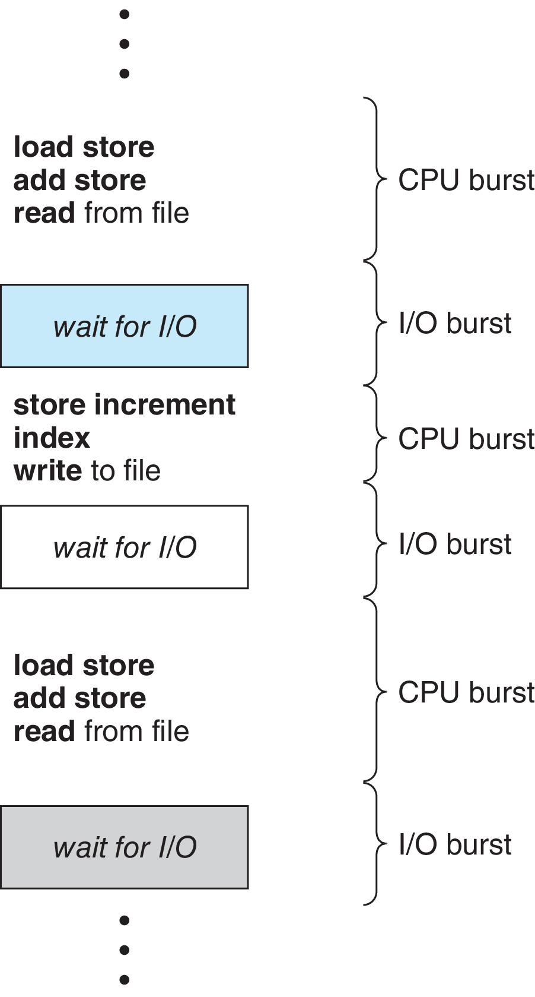
Observation: CPU, I/O Bursts
Process can ‘wait’ for an event (disk I/O, read from keyboard, etc. )
During this period another process can be scheduled
CPU–I/O Burst Cycle:
  Process execution consists of a cycle of CPU execution and I/O wait
  CPU burst followed by I/O burst
  CPU burst distribution is of main concern

Slide 5
Let’s understand the problem
Programs have alternate CPU and I’O bursts
  Some are CPU intensive
  Some are I/O intensive
  Some are mix of both
A C program example:
f(int i, int j, int k) {
j = k * i; // CPU burst
scanf("%d", &i); // I/O burst
k = i * j;// CPU burst
printf("%d\n", k):// I/O burst
return k;
}

Slide 6
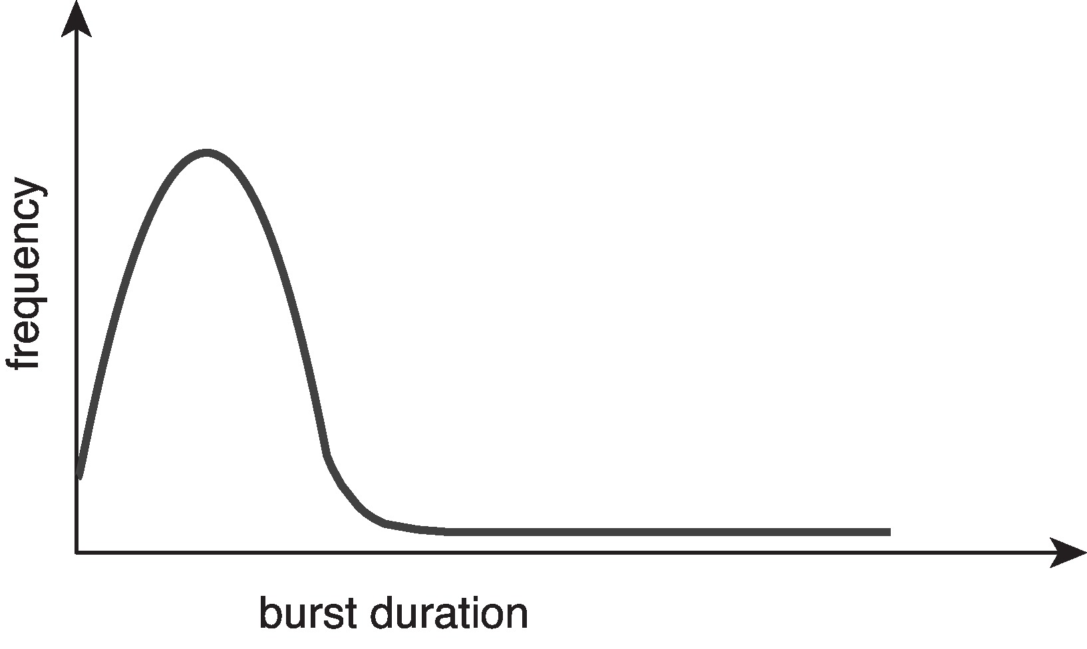
CPU bursts: observation
Large number of short bursts
Small number of longer bursts

Slide 7
Scheduler, what does it do?
From a list of processes, ready to run
  Selects a process for execution
  Allocates a CPU to the process for execution
  Does “context switch”
    Context: Set of registers
    Switch from context of one process to another process
    May be done like this: P1 context -> scheduler context -> P2 context

Slide 8
When is scheduler invoked?
Process Switches from running to waiting state
  Waiting for I/O, etc.
Switches from running to ready state
  E.g. on a timer interrupt
Switches from waiting to ready
  I/O wait completed, now ready to run
Terminates
Scheduling under 1 and 4 is nonpreemptive
All other scheduling is preemptive
  Consider access to shared data
  Consider preemption while in kernel mode
  Consider interrupts occurring during crucial OS activities

Slide 9
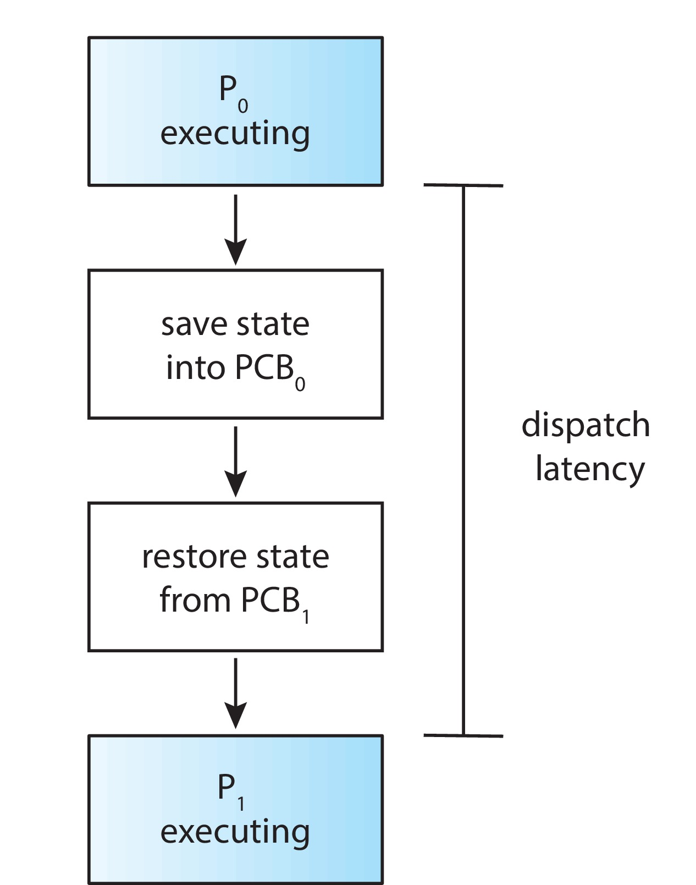
Dispatcher: A part of scheduler
Gives control of the CPU to the process selected by the short-term scheduler; this involves:
  switching context
  switching to user mode
  jumping to the proper location in the user program to restart that program
Dispatch latency
  time taken to stop one process and start another running
Xv6: swtch(), some tail end parts of sched(), trap(), trapret()

Slide 10
Dispatcher in action on Linux
Run “vmstat 1 3”
  Means run vmstat 3 times at 1 second delay
In output, look at CPU:cs
  Context switches every second
Also for a process with pid 3323
Run
“cat /proc/3323/status”
  See
  voluntary_ctxt_switches
  --> Process left CPU
  nonvoluntary_ctxt_switche
  --> Process was preempted

Slide 11
Scheduling criteria
CPU utilization: Maximise
  keep the CPU as busy as possible. Linux: idle task is scheduled when no process to be scheduled.
Throughput : Maximise
  # of processes that complete their execution per time unit
Turnaround time : Minimise
  amount of time to execute a particular process
Waiting time : Minimise
  amount of time a process has been waiting in the ready queue
Response time : Minimise
  amount of time it takes from when a request was submitted until the first response is produced, not output (for time-sharing environment)

Slide 12
Calculations of different criteria
If you want to evaluate an algorithm practically, you need a proper workload !
  Processes with CPU and I/O bursts
  Different durations of CPU bursts
  Different durations of I/O bursts
    How to do this programmatically?
    How to ensure that after 2 seconds an I/O takes place?
  Need periods when system will be “idle” – no process schedulable !

Slide 13
Calculations of different criteria
CPU Utilization
  % time spent in doing ‘useful’ work
  What is useful work?
    On linux
      there is an “idle” thread, scheduled when no other task is RUNNABLE
      Not running idle thread is productive work
      Includes process + scheduling time + interrupts
    On other systems?
      Need to define
    On xv6
      We can say that time spent in the loop selecting a process is idle work

Slide 14
Calculations of different criteria
Throughput
  # processes that complete execution per unit time
  Formula: total # processes completed / total time
  Simply divide by your total workload that completed by the time taken
  Depends on the workload as well. ‘long’ or ‘short’ processes.
  If too many short processes , then throughput may appear to be high, like 10s of processes per second

Slide 15
Calculations of different criteria
Turnaround time
  Amount of time required for one process to complete
  For every process, note down the starting and ending time, difference is TA-time
  For process P1 -> Time when process ended – time when process started
    = Sum of time spent in (ready queue + running + waiting for I/O)
  Do the average TA-time

Slide 16
Calculations of different criteria
Waiting time
  amount of time a process has been waiting in the ready queue.
  To be minimised.
  Part of turn around time
  CPU scheduling does not affect waiting time in I/O queues, it affects time in ready queue

Slide 17
Scheduling Criteria
Response time
  amount of time it takes from when a request was submitted until the first response is produced, not output (for time-sharing environment).
  To be minimised.
  E.g. time between your press of a key , and that key being shown in screen

Slide 18
Challenges in implementing the scheduling algorithms
Not possible to know number of CPU and I/O bursts and the duration of each before the process runs !
  Although when we do numerical problems around each algorithm, we assume some values for CPU and I/O bursts !

Slide 19
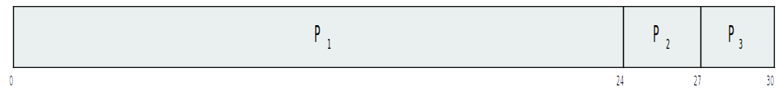
GANTT chart
A timeline chart showing the sequence in which processes get scheduled
Used for analysing a scheduling algorithm

Slide 20
Scheduling Criteria:
Differing requirements
Different uses need different treatment of the scheduling criteria
Knowing the workload is a challenge
E.g. a desktop system
  Response time is important
    Minimize average response time Vs minimize variance in response time?
    Sometimes fast, sometimes slow Vs Reasonable and predictable response time

Slide 21
Our discussion on scheduling algorithms
Analysis with only one CPU burst per process
  Ideally we should do for hundreds of CPU bursts
Only waiting time considered as criteria

Slide 22
Scheduling Algorithms

Slide 23
First- Come, First-Served (FCFS) Scheduling
Process Burst Time
P1 24
P2 3
P3 3
Suppose that the processes arrive in the order: P1 , P2 , P3
The Gantt Chart for the schedule is:
Waiting time for P1 = 0; P2 = 24; P3 = 27
Average waiting time: (0 + 24 + 27)/3 = 17
Non Pre-emptive algorithm

Slide 24
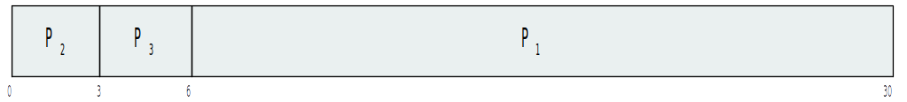
FCFS Scheduling (Cont.)
Suppose that the processes arrive in the order:
P2 , P3 , P1
The Gantt chart for the schedule is:
Waiting time for P1 = 6; P2 = 0; P3 = 3
Average waiting time: (6 + 0 + 3)/3 = 3
Much better than previous case

Slide 25
FCFS: Convoy effect
Consider one CPU-bound and many I/O-bound processes
CPU bound process is scheduled, I/O bound processes are waiting in I/O queues
I/O bound processes finish I/O and move to ready queue, and wait for CPU bound process to finish
  I/O devices Idle
CPU bound process over, goes for I/O. I/O bound processes run quickly, move to I/O queues again
  CPU idle
CPU bound process will run when it’s ready to run
Same process will repeat
--> Lower CPU utilisation
  Better if I/O bound processes run first

Slide 26
FCFS: further evaluation
Troublesome for interactive processes
  CPU bound process may hog CPU
  Interactive process may not get a chance to run early and response time may be quite bad

Slide 27
Shortest-Job-First (SJF) Scheduling
Associate with each process the length of its next CPU burst
  Use these lengths to schedule the process with the shortest time. Better name – Shortest Next CPU Burst Scheduler
SJF is optimal – gives minimum average waiting time for a given set of processes
  The difficulty is knowing the length of the next CPU request
  Could ask the user – bad idea, unlikely to know!

Slide 28
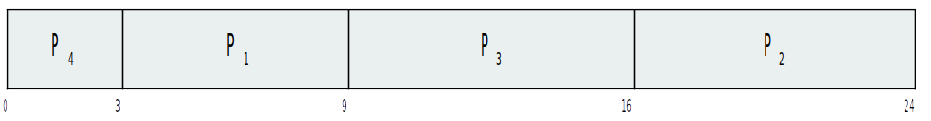
Example of SJF
Process Burst Time
P1 6
P2 8
P3 7
P4 3
SJF scheduling chart
Average waiting time = (3 + 16 + 9 + 0) / 4 = 7

Slide 29
Determining Length of Next CPU Burst
Not possible to implement SJF as can’t know “next” CPU burst. Can only estimate the length – should be similar to the previous one
  Then pick process with shortest predicted next CPU burst
Can be done by using the length of previous CPU bursts, using exponential averaging
Commonly, α set to ½
Preemptive version called shortest-remaining-time-first
τ _{n+1} = α t _{n} + (1 − α)τ _{n} .

Slide 30
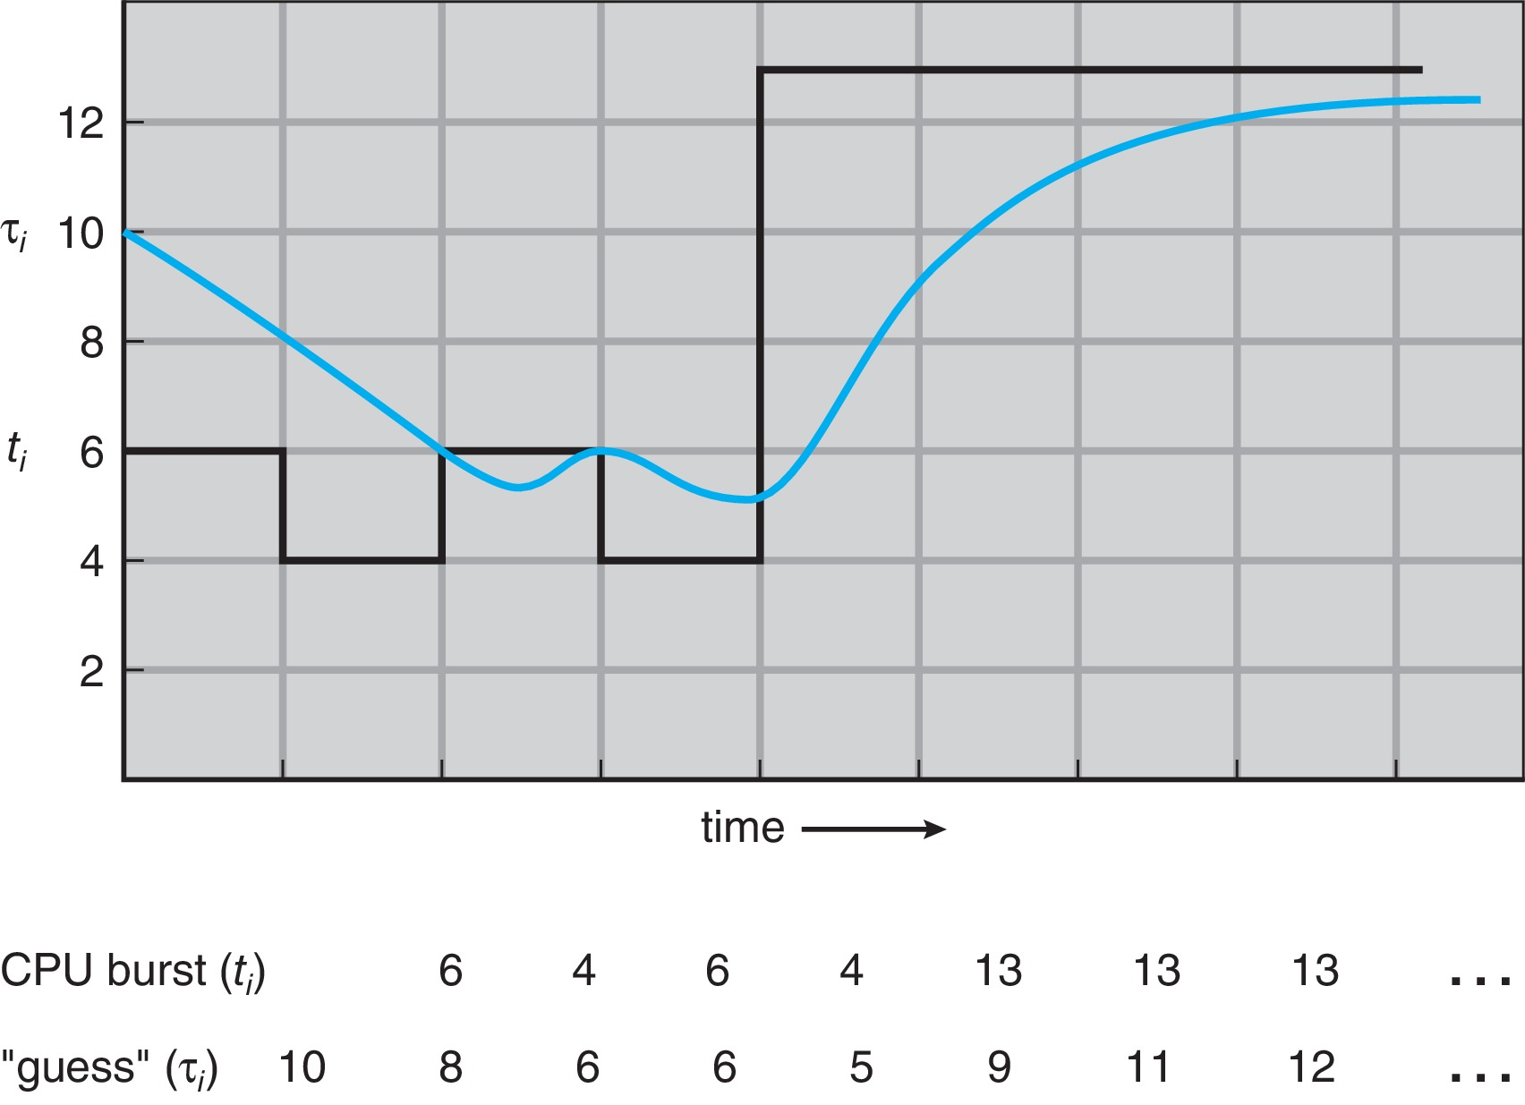
Prediction of the Length of the Next CPU Burst
Α = 1/2 , τ ₀ ₌ 10

Slide 31
Examples of Exponential Averaging
α =0
  τ_{n+1} = τ_{n}
  Recent history does not count
α =1
  τ_{n+1} = α t_{n}
  Only the actual last CPU burst counts
If we expand the formula, we get:
  τ_{n+1} = α t_{n}+(1 - α)α t_{n} ₋₁ + …
  +(1 - α )^{j} α t_{n} _{-j} + …
  +(1 - α )^{n +1} τ₀
Since both α and (1 - α) are less than or equal to 1, each successive term has less weight than its predecessor

Slide 32
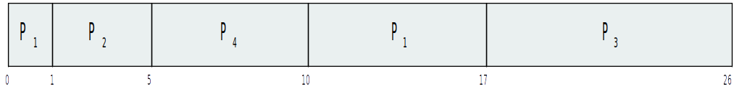
Example of Shortest-remaining-time-first
Preemptive SJF = SRTF. Now we add the concepts of varying arrival times and preemption to the analysis
Process Arrival Time Burst Time
P1 0 8
P2 1 4
P3 2 9
P4 3 5
Preemptive SJF Gantt Chart
Average waiting time = [(10-1)+(1-1)+(17-2)+(5-3)]/4 = 26/4 = 6.5 msec

Slide 33
Round Robin (RR) Scheduling
Each process gets a small unit of CPU time (time quantum q), usually 10-100 milliseconds.
  After this time has elapsed, the process is preempted and added to the end of the ready queue.
If there are n processes in the ready queue and the time quantum is q, then each process gets 1/n of the CPU time in chunks of at most q time units at once.
  No process waits more than (n-1)q time units.

Slide 34
Round Robin (RR) Scheduling
Timer interrupts every quantum to schedule next process
Performance
  q large ⇒ FIFO
  q small ⇒ q must be large with respect to context switch, otherwise overhead is too high

Slide 35
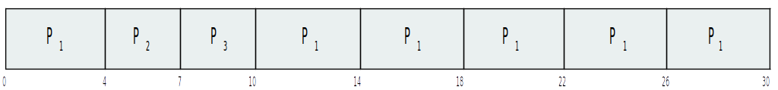
Example of RR with Time Quantum = 4
Process Burst Time
P₁ 24
P₂ 3
P₃ 3
The Gantt chart is:
Typically, higher average turnaround than SJF, but better response
q should be large compared to context switch time
q usually 10ms to 100ms, context switch < 10 usec

Slide 36
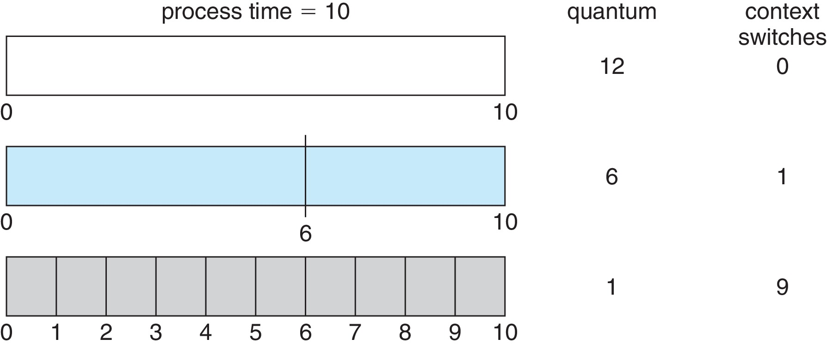
Time Quantum and Context Switch Time

Slide 37
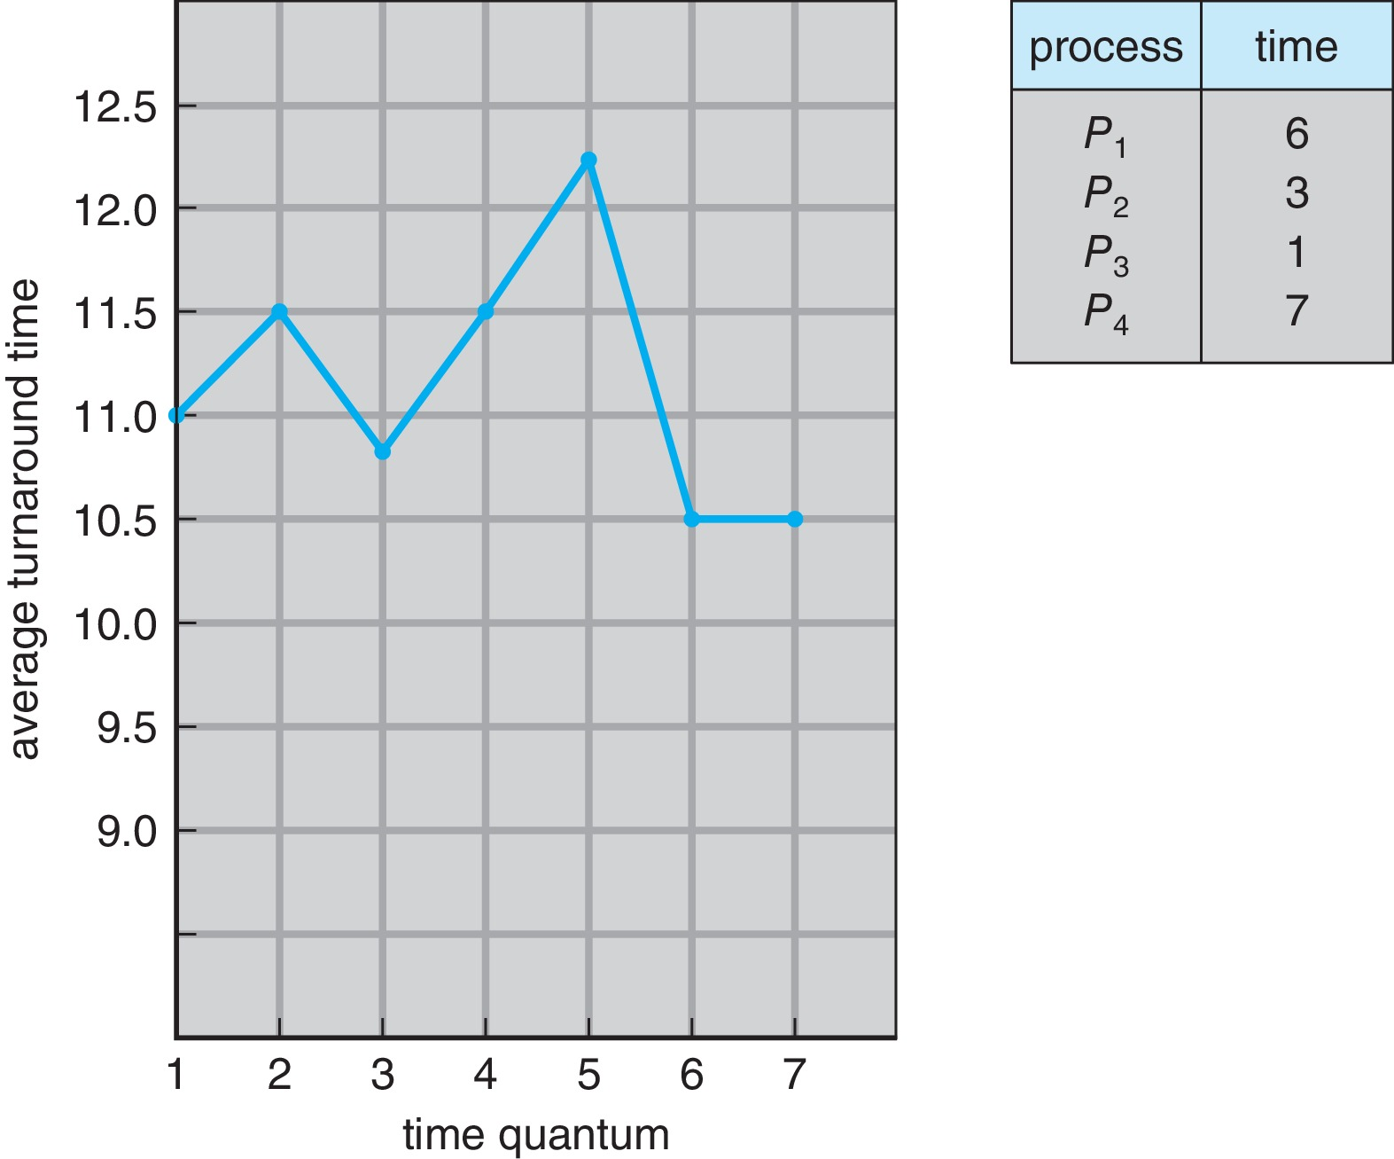
Turnaround Time Varies With The Time Quantum
80% of CPU bursts should be shorter than quantum

Slide 38
Priority Scheduling
A priority number (integer) is associated with each process
The CPU is allocated to the process with the highest priority (smallest integer ≡ highest priority)
  Preemptive (timer interrupt, more time for more priority)
  Nonpreemptive (no timer interrupt, just schedule process with highest priority)
SJF is priority scheduling where priority is the inverse of predicted next CPU burst time
Problem ≡ Starvation – low priority processes may never execute
Solution ≡ Aging – as time progresses increase the priority of the process

Slide 39
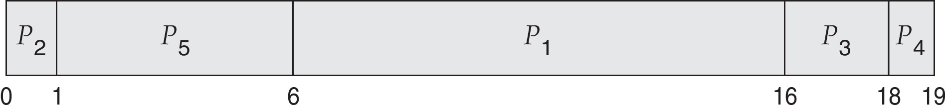
Example of Priority Scheduling
ProcessA arr i Burst TimeT Priority
P₁ 10 3
P₂ 1 1
P₃ 2 4
P₄ 1 5
P₅ 5 2
Priority scheduling Gantt Chart
Average waiting time = 8.2 msec

Slide 40
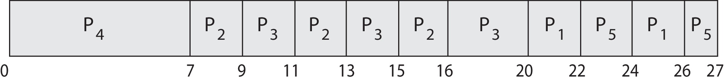
Priority Scheduling with
Round-Robin
ProcessA arri Burst TimeT Priority
P₁ 4 3
P₂ 5 2
P₃ 8 2
P₄ 7 1
P₅ 3 3
Run the process with the highest priority. Processes with the same priority run round-robin
Gantt Chart with 2 ms time quantum

Slide 41
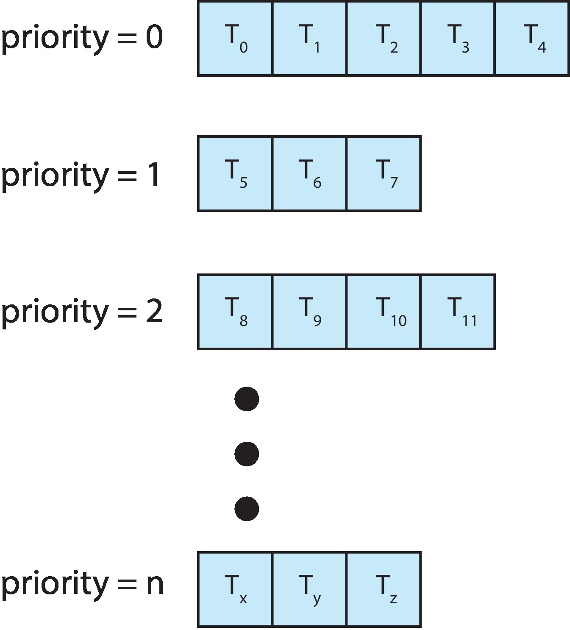
Multilevel Queue
With priority scheduling, have separate queues for each priority.
Schedule the process in the highest-priority queue!

Slide 42
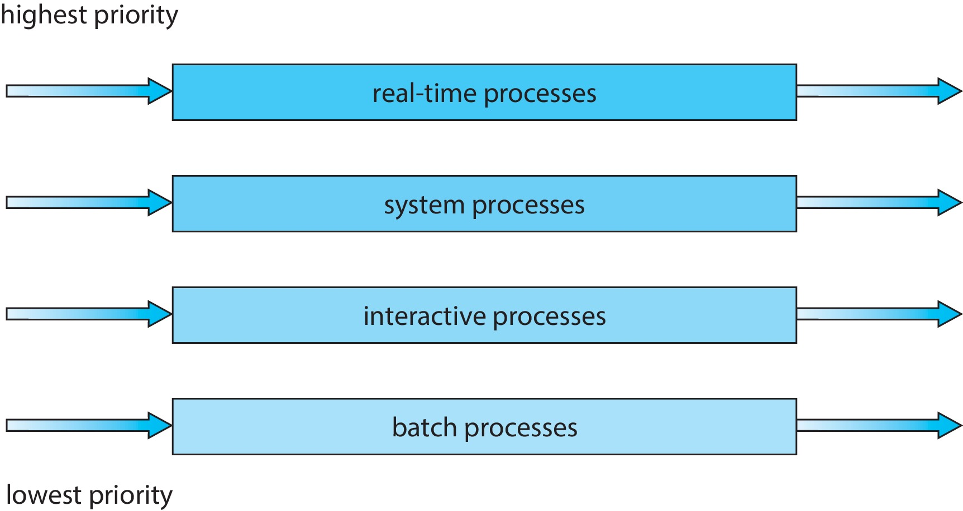
Multilevel Queue

Slide 43
Implementing multilevel queue
Processes need to have a priority
  Either modify fork()/exec() to have a priority
  Or add a nice() system call to set priority
How to know the priority?
  The end user of the computer system needs to know this from needs of real life
  E.g. on a database system, the database process will have a higher priority than other processes

Slide 44
Multilevel Feedback Queue
A process can move between the various queues; aging can be implemented this way
Multilevel-feedback-queue scheduler defined by the following parameters:
  number of queues
  scheduling algorithms for each queue
  method used to determine when to upgrade a process
  method used to determine when to demote a process
  method used to determine which queue a process will enter when that process needs service

Slide 45
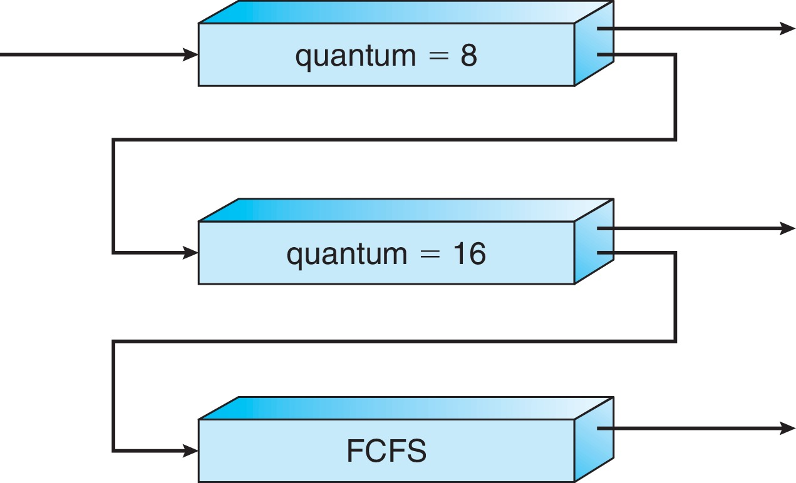
Example of Multilevel Feedback Queue
Three queues:
  Q₀ – RR with time quantum 8 milliseconds
  Q₁ – RR time quantum 16 milliseconds
  Q₂ – FCFS
Scheduling rules
  Serve all processes in Q0 first
  Only when Q₀ is empty, serve processes in Q₁
  Only when Q₀ and Q₁ are empty, serve processes in Q₂

Slide 46
Example of Multilevel Feedback Queue
Scheduling
  A new job enters queue Q₀
    When it gains CPU, job receives 8 milliseconds
    If it does not finish in 8 milliseconds, job is moved to queue Q₁
  At Q₁ job receives 16 additional milliseconds
    If it still does not complete, it is preempted and moved to queue Q₂
  To prevent starvation, move a process from lower-priority queue to higher priority queue after it has waited for too long

Slide 47
Thread Scheduling
Distinction between user-level and kernel-level threads
When threads supported, threads scheduled, not processes
Many-to-one and many-to-many models, thread library schedules user-level threads to run on LWP
  Known as process-contention scope (PCS) since scheduling competition is within the process
  Typically done via priority set by programmer
Kernel thread scheduled onto available CPU is system-contention scope (SCS) – competition among all threads in system

Slide 48
Pthread Scheduling
PTHREAD_SCOPE_PROCESS schedules threads using PCS scheduling
PTHREAD_SCOPE_SYSTEM schedules threads using SCS scheduling
Linux and macOS only allow PTHREAD_SCOPE_SYSTEM
Let’s see a Demo using a program

Slide 49
Multi Processor
Scheduling

Slide 50
Multiprocessor systems
Each processor has separate set of registers
  All: eip, esp, cr3, eax, ebx, etc.
Each processor runs independently of others
Main difference is in how do they access memory

Slide 51
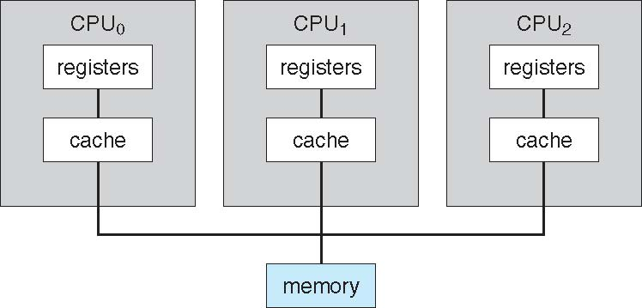
Symmetric multiprocessing (SMP)

Slide 52
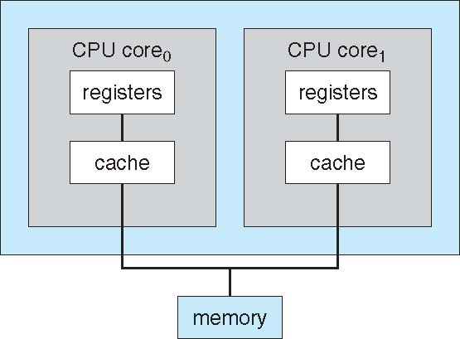
Multicore systems (also SMP)
No difference from the perspective of OS. The hardware ensures that OS sees multiple processors and not multiple cores.

Slide 53
Booting multi-processor systems
X86 + xv6
  One processor starts, runs BIOS, loads kernel, initializes kernel data structures
  Mpinit() : first processor scans certain memory addresses for information about other processors and obtains configuration and configures them
  Startothers() : First processor initializes kernel data structures for other processors , and ensures that other processors start in scheduler() and starts them
  First processor “starts” other processors

Slide 54
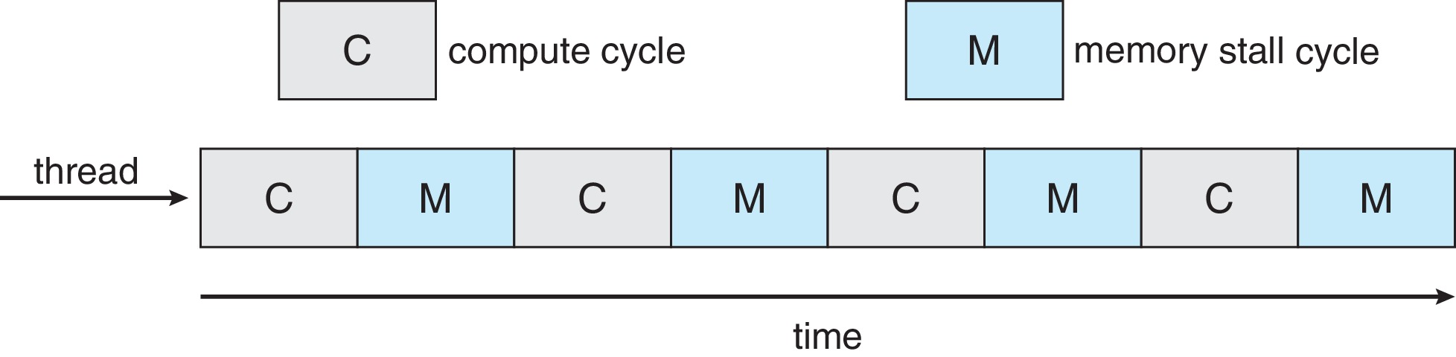
Multicore Processors
Recent trend to place multiple processor cores on same physical chip
Faster and consumes less power
Multiple threads per core also growing
  Takes advantage of memory stall to make progress on another thread while memory retrieve happens

Slide 55
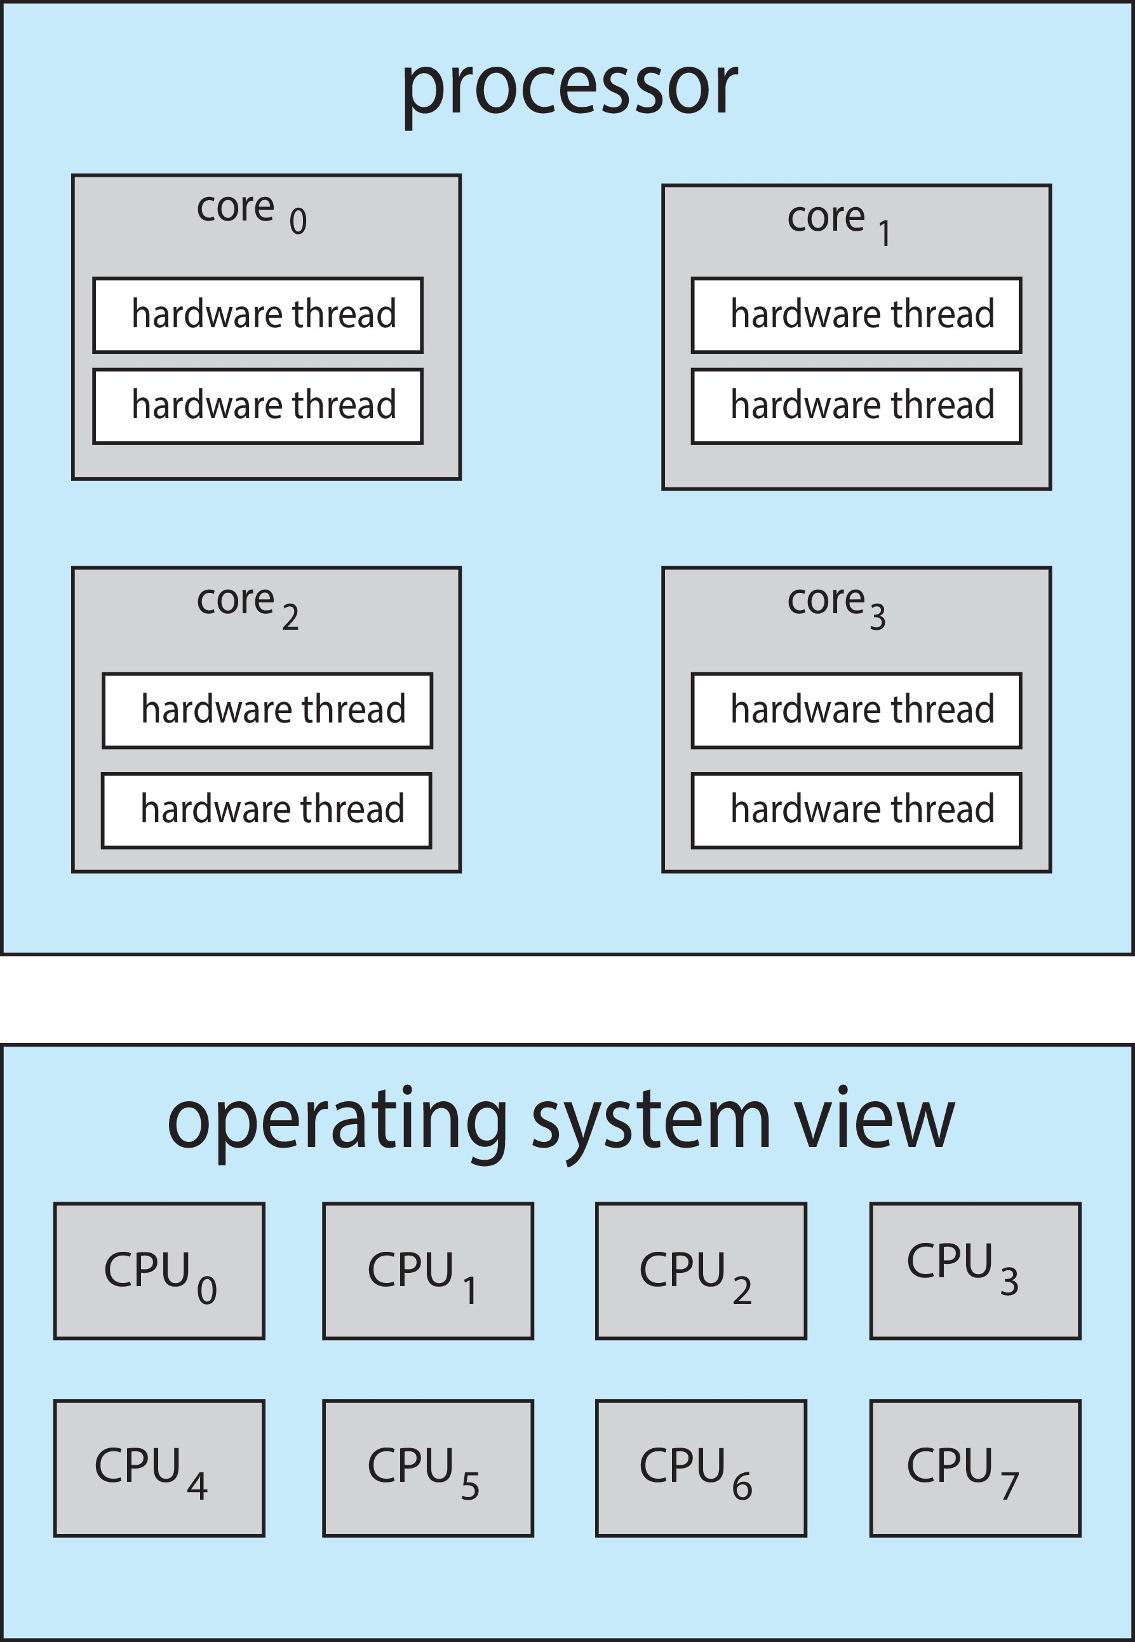
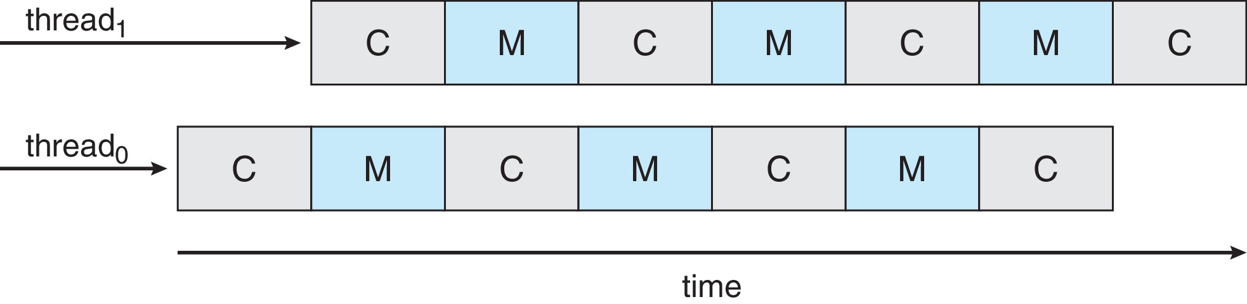
Multithreaded Multicore System
Each core has > 1 hardware threads.
Chip-multithreading (CMT) assigns each core multiple hardware threads. (Intel refers to this as hyperthreading.)
On a quad-core system with 2 hardware threads per core, the operating system sees 8 logical processors.
If one thread has a memory stall, switch to another thread!

Slide 56
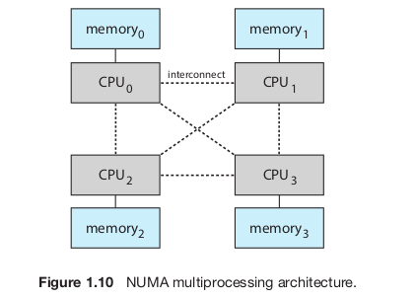
Non-Uniform Memory Architecture (NUMA)

Slide 57
More on SMP systems
During booting – each CPU needs to be turned on
  Special I/O instructions writing to particular ports
  See lapicstartap() in xv6
  Need to setup CR3 on each processor
  Segmentation, Page tables are shared (same memory for all CPUs)
All processors will keep running independently of each other
Different interrupts on each processor – each needs IDT setup
Each processor will be running processes, interrupt handlers, syscalls
Synchronization problems !
How to do scheduling ?

Slide 58
Multiple-Processor Scheduling
CPU scheduling more complex when multiple CPUs are available
Multiprocess may be any one of the following architectures:
  Multicore CPUs
  Multithreaded cores
  NUMA systems
  Heterogeneous multiprocessing

Slide 59
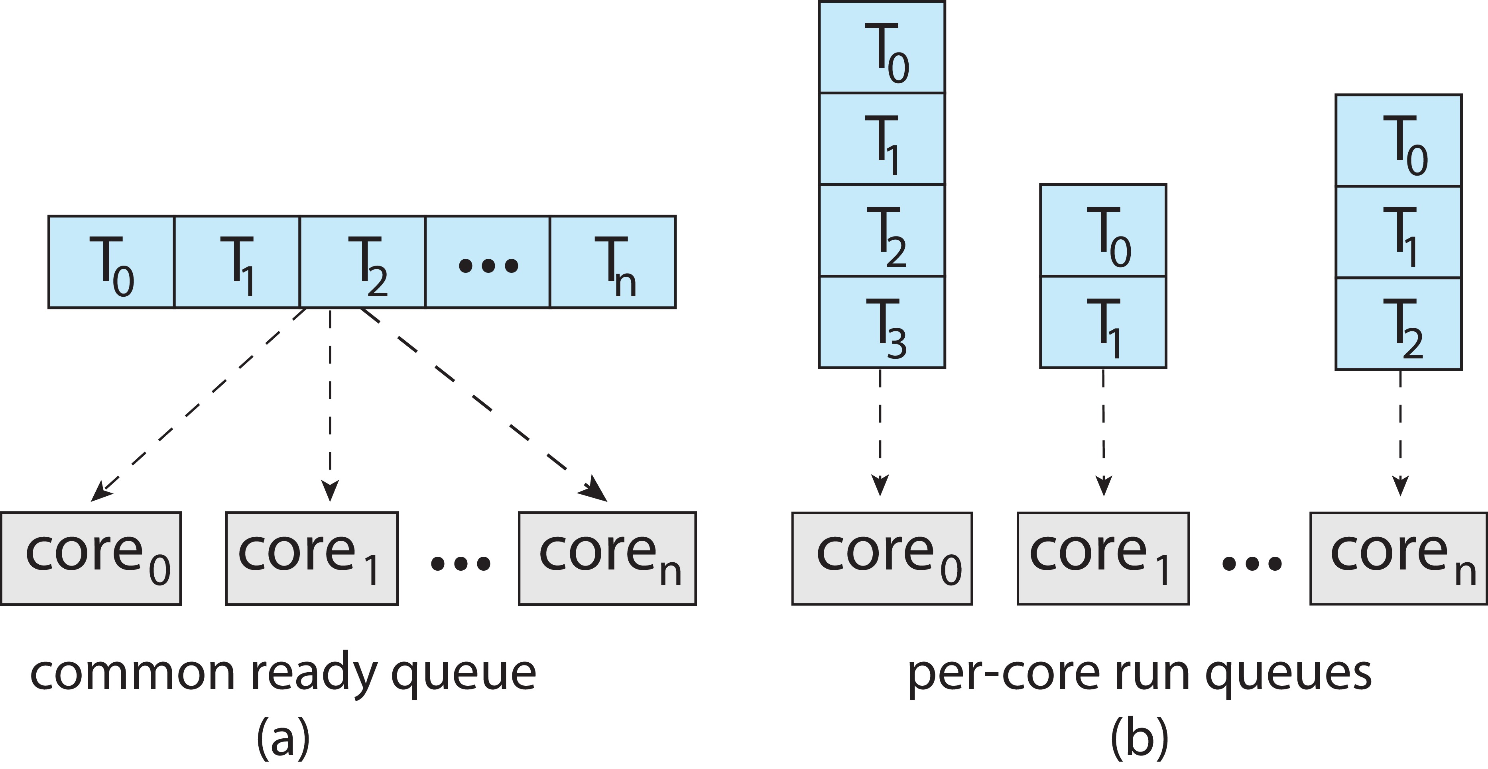
Multiple-Processor Scheduling
Symmetric multiprocessing (SMP) is where each processor is self scheduling.
All threads may be in a common ready queue (a)
Each processor may have its own private queue of threads (b)

Slide 60
Multiple-Processor Scheduling – Load Balancing
If SMP, need to keep all CPUs loaded for efficiency
Load balancing attempts to keep workload evenly distributed
Push migration – periodic task checks load on each processor, and if found pushes task from overloaded CPU to other CPUs
Pull migration – idle processors pulls waiting task from busy processor

Slide 61
Multiple-Processor Scheduling –
Load Balancing
When a thread has been running on one processor, the cache contents of that processor stores the memory accesses by that thread.
We refer to this as a thread having affinity for a processor (i.e. “processor affinity”)
Load balancing may affect processor affinity as a thread may be moved from one processor to another to balance loads, yet that thread loses the contents of what it had in the cache of the processor it was moved off of.

Slide 62
Multiple-Processor Scheduling –
Load Balancing
Soft affinity – the operating system attempts to keep a thread running on the same processor, but no guarantees.
Hard affinity – allows a process to specify a set of processors it may run on.

Slide 63
SMP in xv6
Only one process queue
No load balancing, no affinity
A process may run any CPU burst /alloted-time-quantum on any processor randomly
See the code of:
  Startothers(), mpenter(), mpmain()
Different scheduler’s kernel stack on each processor
  Done in startothers()
Each processor calls scheduler() from mpmain()

Slide 64
End

